Slide 1

Interfacing LCD with LPC4088
DAY 19
EMBEDDED SYSTEM DESIGN & IoT-Master Class

Slide 2
What You will learn Today?
What is LCD
How it works
LCD Interface with LPC4088

Slide 3
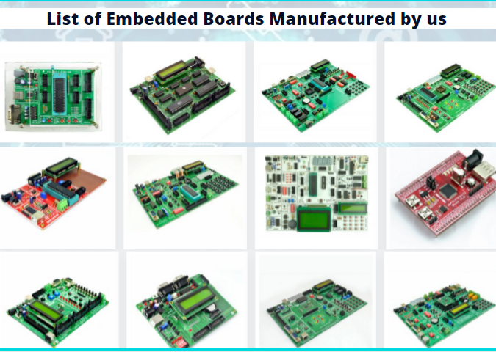
About Pantech
Started in the Year 2004
Lab equipments and Sensor Interface
Manufacturer of Brainsense EEG Headset
Reconfigurable Algorithms on AI
Manufacture of AI development Boards
Power electronics, Fuel cell and Renewable Energy trainers
www.pantechsolutions.net

Slide 4

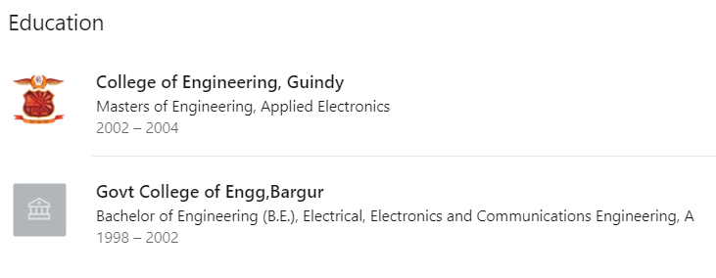
About me
My Primary Expertise
Microcontroller Architecture: 8051,PIC,AVR,ARM,MSP430,PSOC3 DSP Architecture: Blackfin,C2000,C6000,21065L Sharc FPGA: Spartan,Virtex,Cyclone Image Processing Algorithms: Image/Scene Recognition, Machine Learning, Computer Vision, Deep Learning, Pattern Recognition, Object Classification ,Image Retrieval, Image enhancement and denoising. Neural Networks : SVM,RBF,BPN Cryptography :RSA,DES,3DES,Ellipti curve,Blowfish,Diffe Hellman Compilers: Keil,Visual DSP++,CCS, Xilinx Platform studio,ISE, Matlab, Open CV
https://www.linkedin.com/in/jeevarajan/
www.pantechsolutions.net

Slide 5
Announcement
Attendance Link at 9 pm
Minimum attendance required for an E-Certificate is 27 Days. Attendance link will be valid for 1 hrs. after the event.
For Internship Candidates no attendance required ,it will be accessed from the LMS Portal. (learn.pantechsolutions.net)
Recorded Video Streaming for LAB classes to improve Learning Experience
8051 – 5 Days workshop –use the same attendance form
support.pantechsolutions.net

Slide 6

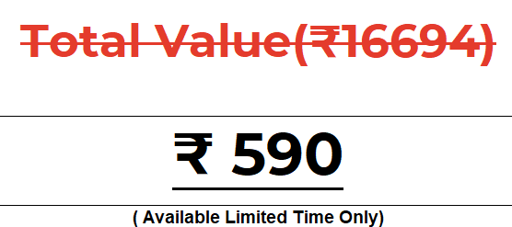
What you get on 30 Days Internship

Slide 7
Mindset Lesson for the Day
Be Fixed On Your Goal, But Flexible On How You Got There

Slide 8
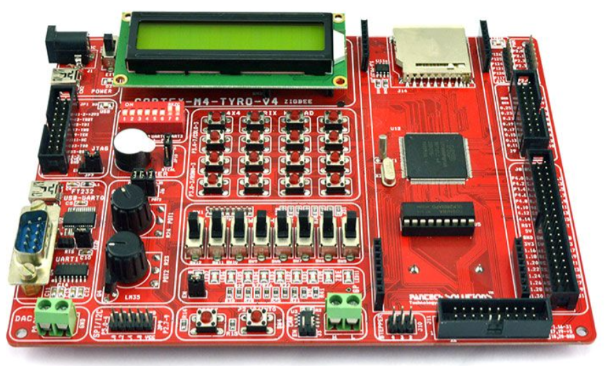
Embedded Sytem Design using Cortex M4-LPC4088

Slide 9
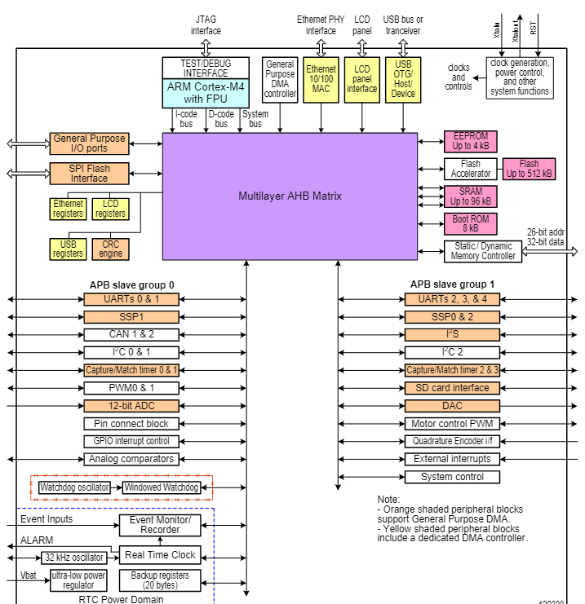
LPC4088 BLOCK DIAGRAM

Slide 10
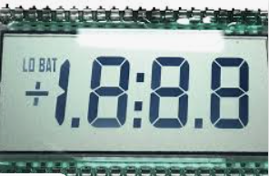
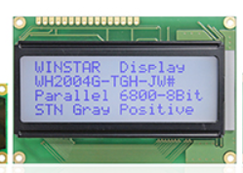
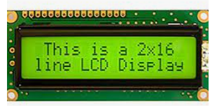
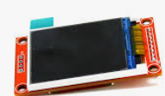
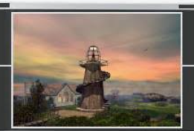
What is LCD
A liquid-crystal display (LCD) is a flat-panel display or other electronically modulated optical device that uses the light-modulating properties of liquid crystals combined with polarizers. Liquid crystals do not emit light directly,[1] instead using a backlight or reflector to produce images in color or monochrome

Slide 11
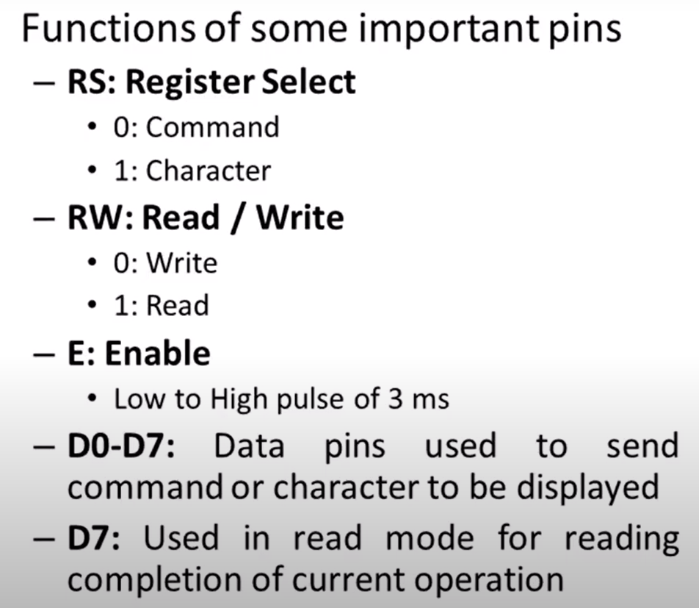
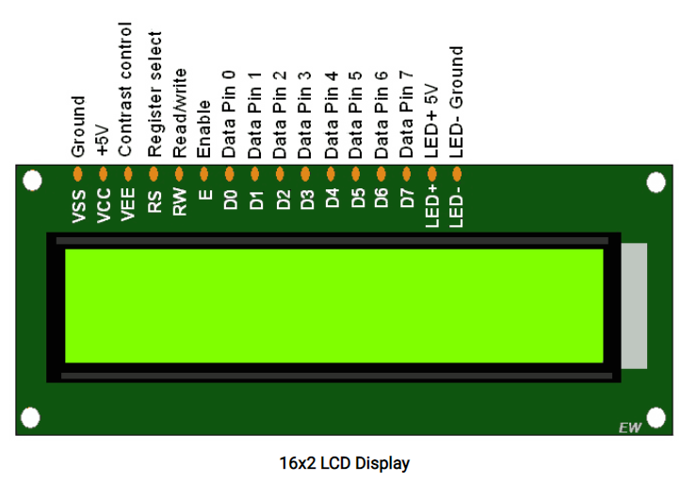
PIN Details of LCD

Slide 12
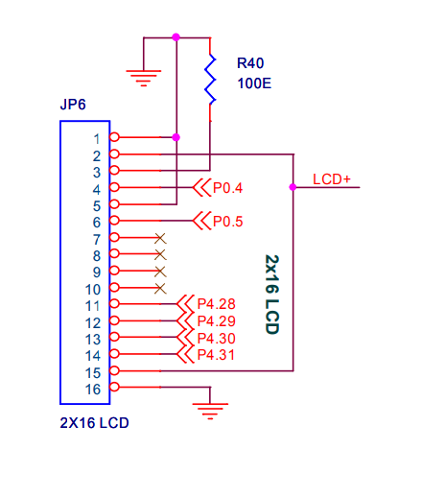
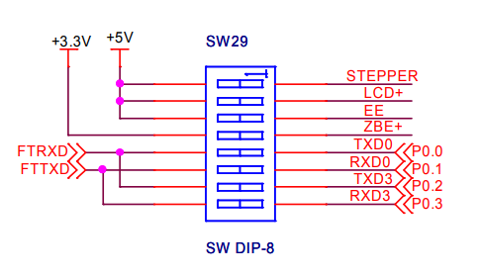
Schematic Diagram of LCD

Slide 13
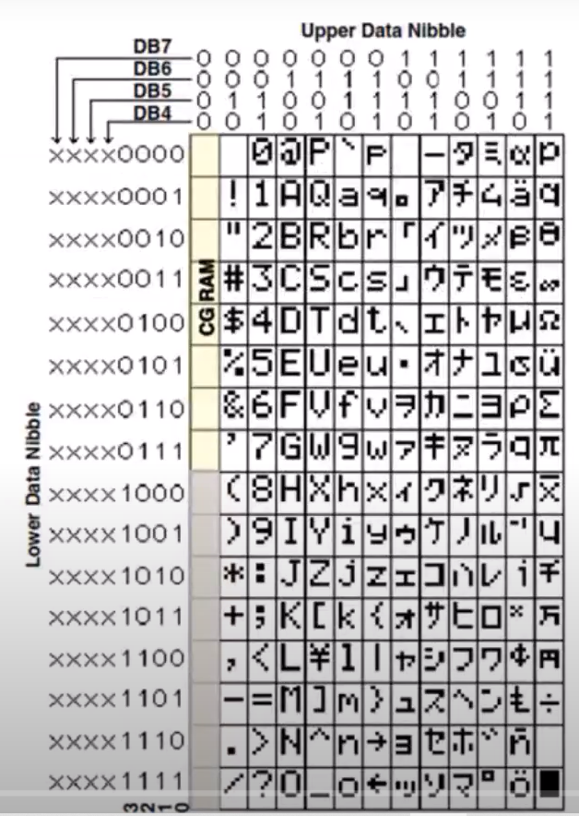
Character Display LCD
0011 0001 -X”31”
0011 0010 -X”32”

Slide 14
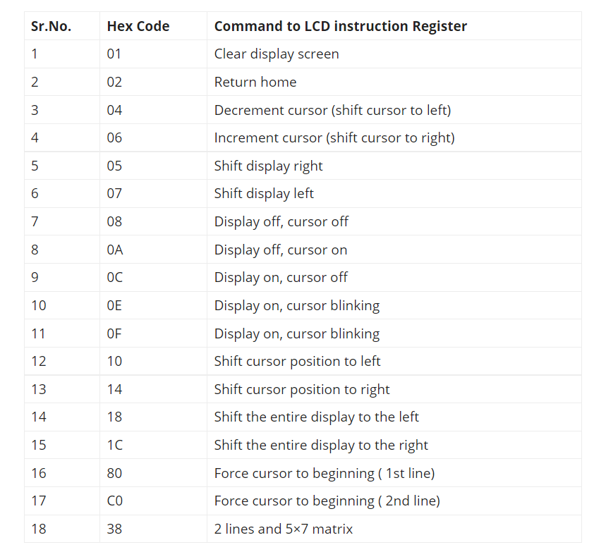
COMMAND CODES

Slide 15
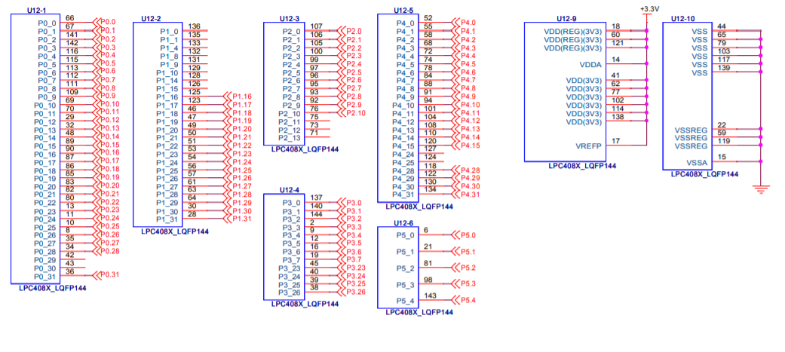
LPC4088

Slide 16
Header File Declaration
#include "LPC407x_8x_177x_8x.h"
#define RS_PORT (0)
#define RS_PIN (4)
#define RS_VAL (1 << RS_PIN)
#define EN_PORT (0)
#define EN_PIN (5)
#define EN_VAL (1 << EN_PIN)
#define DATA LPC_GPIO4->PIN
//data array
unsigned char Lcd_LINE1[]={"CORTEX DEV BOARD"},i=0;
unsigned char Lcd_LINE2[]={"LCD DEMO PROGRAM"};
void delay_ms(long ms);
void lcd_command(unsigned char cmd);
void lcd_data(unsigned char data);
void lcd_init(void);

Slide 17
LCD Command
void lcd_command(unsigned char cmd)
{
//5. Clear RS pin--Command mode
LPC_GPIO0->CLR |= RS_VAL;
//6. Place the MSB 4bits on data lines
DATA=cmd<<24;
//6. Pulse the EN pin
LPC_GPIO0->PIN |= EN_VAL;
LPC_GPIO0->CLR |= EN_VAL;
//7. Place the LSB 4bits on data lines
DATA=cmd<<28;
//7. Pulse the EN pin
LPC_GPIO0->PIN |= EN_VAL;
LPC_GPIO0->CLR |= EN_VAL;
delay_ms(5);
}

Slide 18
LCD Data
void lcd_data(unsigned char data)
{
//8. Set RS pin--data mode
LPC_GPIO0->PIN |= RS_VAL;
//9. Place the MSB 4bits on data lines
DATA=data<<24;
//9. Pulse the EN pin
LPC_GPIO0->PIN |= EN_VAL;
LPC_GPIO0->CLR |= EN_VAL;
//10. Place the LSB 4bits on data lines
DATA=data<<28;
//10. Pulse the EN pin
LPC_GPIO0->PIN |= EN_VAL;
LPC_GPIO0->CLR |= EN_VAL;
delay_ms(5);
}

Slide 19
LCD Initialization
void lcd_init(void)
{
delay_ms(100); //LCD powerup time
lcd_command(0x33); //Wake up
lcd_command(0x32); //Wake up
lcd_command(0x28); //4bit mode
lcd_command(0x0C); //display on and cursor off
lcd_command(0x06); //Entry mode and shift
lcd_command(0x01); //Clear LCD
delay_ms(200); //Give more time to settle
}

Slide 20
Delay
void delay_ms(long ms) // delay 1 ms per count @ CCLK 120 MHz
{
long i,j;
for (i = 0; i < ms; i++ )
for (j = 0; j < 26659; j++ );
}

Slide 21
Thank You

